Slide 1
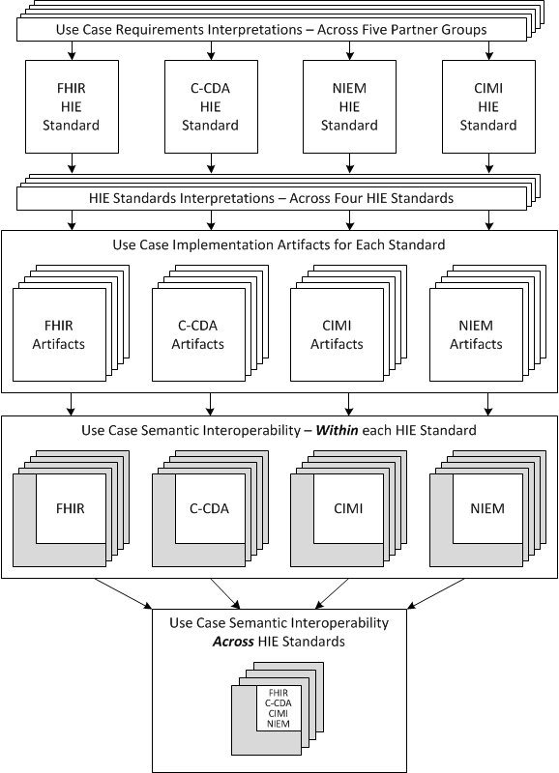
Health Information Exchange (HIE) – Interoperability Current State

Slide 2
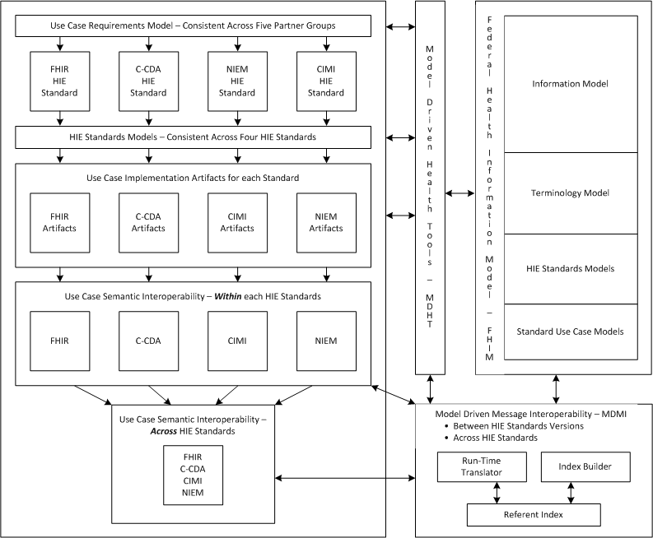
Health Information Exchange (HIE) – Interoperability with FHIM Methodology

